Slide 2


Slide 3

Smith, 130

Slide 4
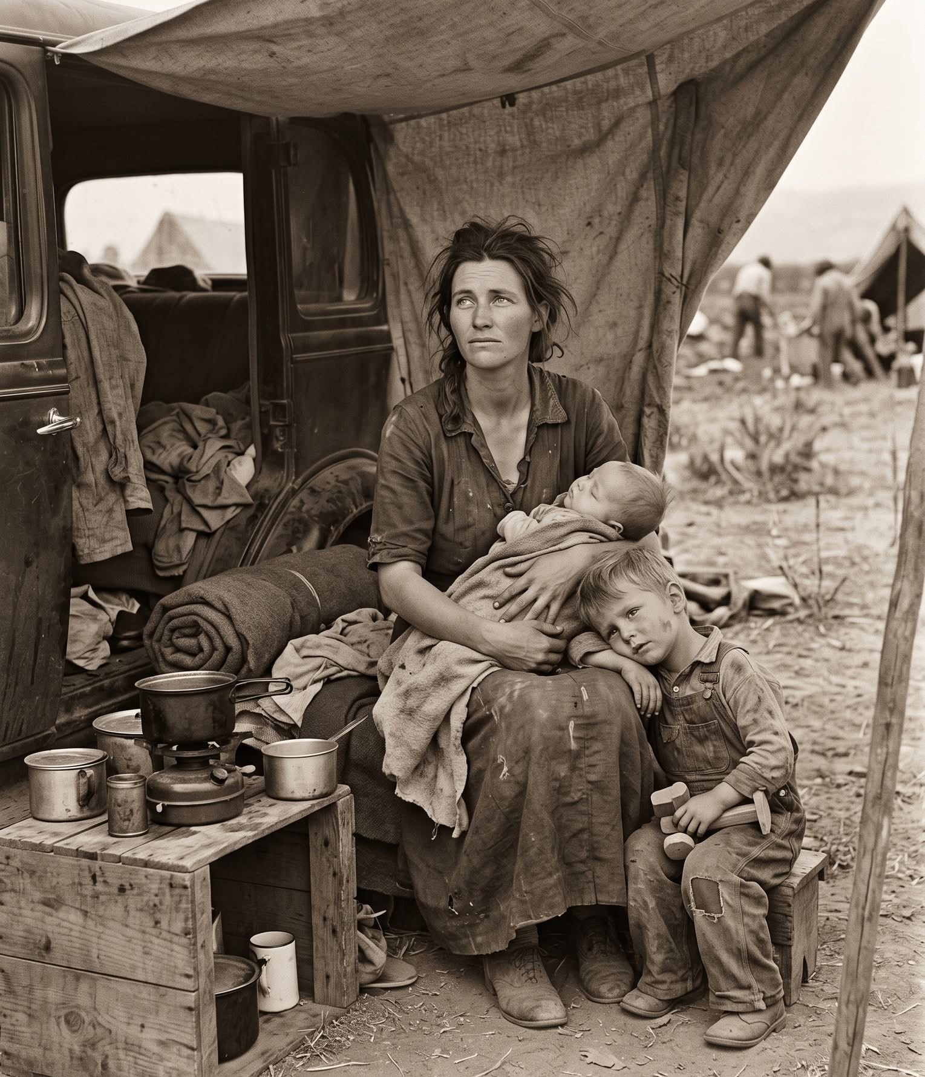
Smith, 130

Slide 5
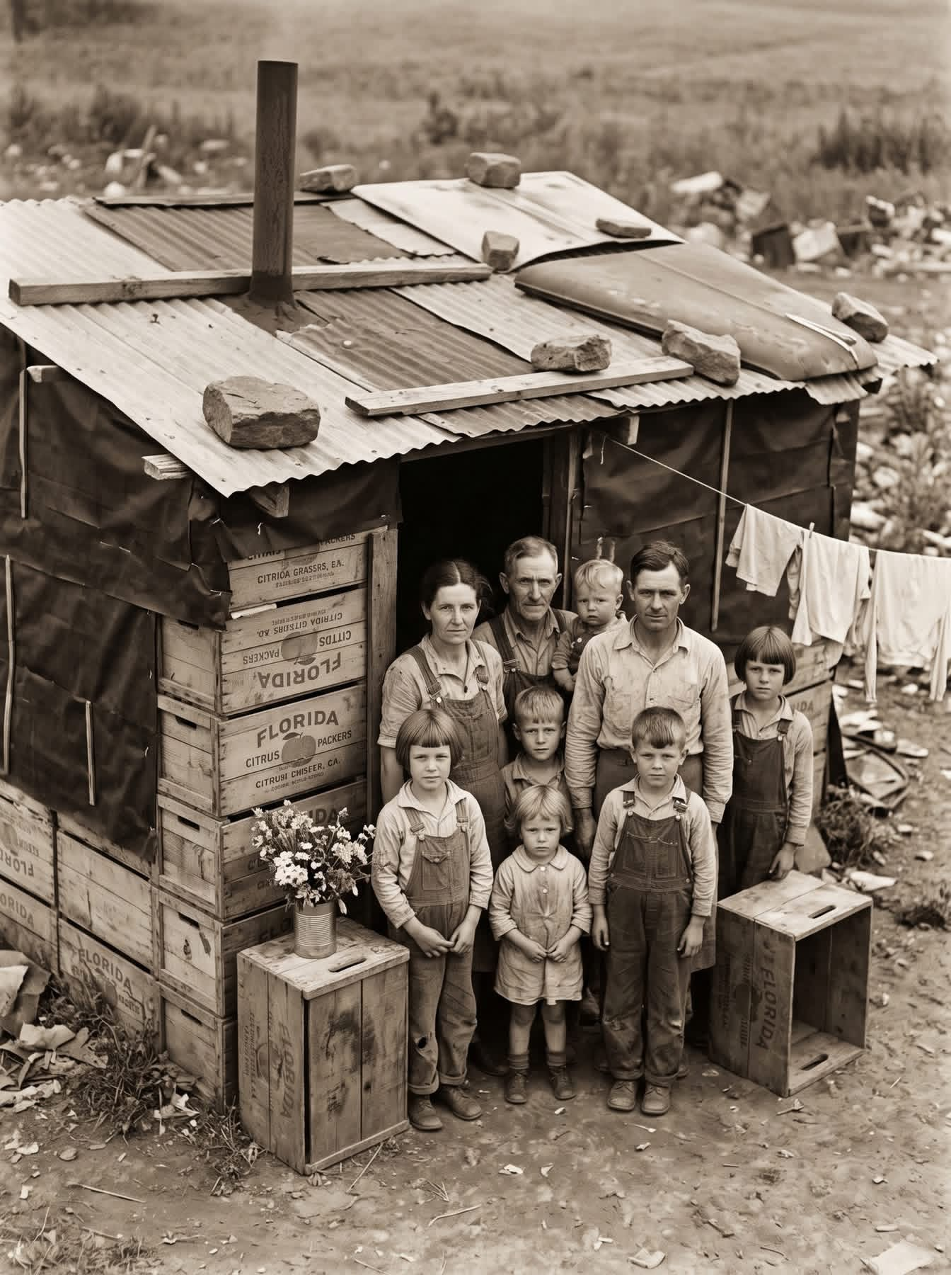
Smith, 130

Slide 6
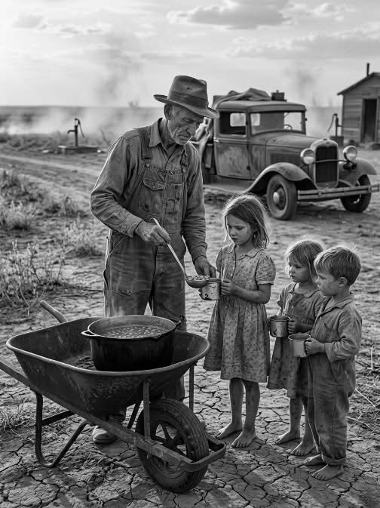
Smith, 130

Slide 7
This Is The True Grace Of God…
1 Peter 5:12
Salvation - Living Hope (1:1-12)
Sanctification (1:13–2:10)
Submission (2:11-3:12)
Suffering (3:13-5:14)
Message Of The
Book Of 1 Peter
… “I have written to you briefly, exhorting and testifying that this is the true grace of God. Stand firm in it!”

Slide 8
Grace
Df= God’s Favor
“(in Christian belief) the free and unmerited favor of God,
as manifested in the salvation of sinners and the bestowal of blessings.”

Slide 9

Grace Defined By Many: “Unmerited Favor”
“But the free gift of god is eternal life in christ Jesus our lord.” NASV95
“But the free gift of god is eternal life in christ Jesus our lord.” ESV
“But the gracious gift of God is eternal life in Christ Jesus our Lord.” NASV20
“But the gracious gift of God is eternal life in Christ Jesus our Lord.” LSB
“The Gift” KJV/NKJV
Romans 6:23
5:15-16

Slide 10
Grace (charis (χάρις) In Bible Times and It’s Transformation In The Following Centuries.
When New Testament writers used the Greek word charis (χάρις), their ancient audience did not hear a modern definition like "unmerited favor". They understood it through the lens of Greco-Roman culture, where gifts were transactional, relational, and carried serious social expectations.
New Testament scholars note that while God's initial gift of salvation is completely unearned—meaning the client did nothing to merit the patron’s favor—the gift itself demands absolute allegiance and good works as a response. Accepting God's charis meant accepting Him as your divine Patron, pledging your entire life to His service.
In first-century society, charis was a single word used to describe three distinct parts of a relationship loop:
The Giver’s Attitude: The favor, goodwill, or generosity that moves a wealthy benefactor to bestow a gift.
The Gift Itself: The physical object, money, or favor given by the benefactor.
• The Recipient's Response: The mandatory gratitude, loyalty, and public honor returned by the receiver.
Three Sides Of Ancient χάρις
The Old Testament Foundation The Greek charis also translated the Hebrew concepts of khen (favor) and hesed (covenantal loyalty). In Hebrew thought, grace was not an abstract doctrine but an action: a superior turning their face toward an inferior to rescue them, establishing a mutual
bond of faithfulness.
Note: AI
If you want to explore further, I can provide specific examples of how ancient writers like Seneca or Josephus used charis, or explain how historical events in the 5th century began changing this definition into modern theology. Let me know how you would like to proceed.

Slide 11
Grace
Mercy
His Favor Giving
Me what I don’t deserve.
Not Giving Me What
I Do deserve.
God’s Goodness To Me.
Consider: Matt. 20:1-16 and Luke 15:11-32

Slide 12
Mercy and Grace…
In the Bible, mercy is God withholding the punishment you deserve, while grace is God giving you the blessings and favor you do not deserve - especially, the giving of Jesus Christ to make that possible. While both are distinct expressions of God's love, mercy cancels the debt of your past sin, and grace gives you an inheritance and a future relationship with Him through Christ.

Slide 13
Justify Same Expression As Declared Righteous
The Legacy Standard Bible translates "justified" and "righteous" using a literal, formal equivalence approach, closely following its predecessor the NASB by consistently rendering the Greek verb dikaioō as forms of justify/declared righteous and the noun/adjective family (dikaiosunē / dikaios) as righteousness/righteous.
Translation Characteristics
Justified (dikaioō): Rendered as "justified" or "declares righteous" (e.g., Romans 5:1, Romans 4:5), preserving the forensic, legal concept of a divine declaration rather than moral infusion.
Righteous / Righteousness (dikaios / dikaiosunē): Rendered strictly as "righteous," "righteousness," or "just," maintaining direct word-family consistency between the Old Testament Hebrew (tsaddiq) and New Testament Greek roots.
Commitment to Consistency: As part of its literal translation philosophy, the LSB aims to use the same English equivalents for Greek and Hebrew word families as uniformly as possible across both testaments.

Slide 14
Grace and Law
Justified By
God’s Law?
Justified By
God’s Grace?
Concept Of Many…
Do It All - Law
Do Nothing - Grace
(14) For sin shall not be master over you, for you are not under law but under grace. (15) What then? Shall we sin because we are not under law but under grace? May it never be!
Romans 6:14-15

Slide 15
Grace and Law
For the law of the Spirit of life in Christ Jesus has set you free from the law of sin and of death.
Romans 8:2 (1-11)
Justified By
God’s Grace?
Justified By
God’s Law?
1 Cor. 9:19-23; Js. 1:21-27;
Gal. 6:2; Gal. 4:21- 5:12
Gal 2:16 nevertheless knowing that a man is not justified by the works of the Law but through faith in Christ Jesus, even we have believed in Christ Jesus, so that we may be justified by faith in Christ and not by the works of the Law; since by the works of the Law no flesh will be justified. (17) "But if, while seeking to be justified in Christ, we ourselves have also been found sinners, is Christ then a minister of sin? May it never (18) “For if I rebuild what I have once destroyed, I prove myself to be a transgressor. (19) “For through the Law I died to the Law, so that I might live to God. (20) "I have been crucified with Christ; and it is no longer I who live, but Christ lives in me; and the life which I now live in the flesh I live by faith in the Son of God, who loved me and gave Himself up for me. (21) "I do not nullify the grace of God, for if righteousness comes through the Law, then Christ died needlessly."
Galatians 2:16-21

Slide 16

Titus 2:11-15
(11) For The grace of god has appeared, bringing salvation to all men, (12) instructing us to deny ungodliness and worldly desires and to live sensibly, righteously and godly in the present age, (13) looking for the blessed hope and the appearing of the glory of our great God and Savior, Christ Jesus,
(14) who gave Himself for us to redeem us from every lawless deed, and to purify for Himself a people for His own possession, zealous for good deeds. (15) These things speak and exhort and reprove with all authority. Let no one disregard you.
God’s Grace: Jesus Gave Himself For Us…
What Will I Give Back To Him In Thankfulness?

Slide 17
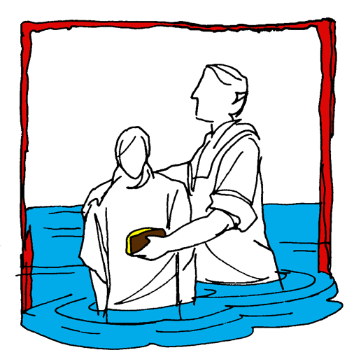

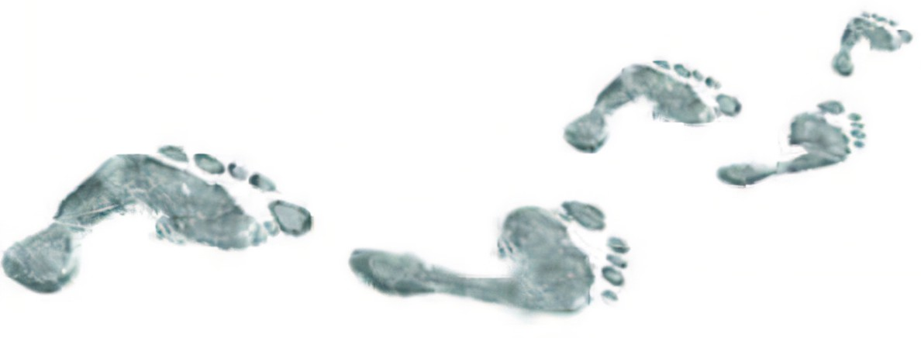
Hear (Rom. 10:17)
Believe (Jn. 8:24)
Repent (Acts 2:38)
Confess (Mt. 10:32-33)
Baptism (Acts 22:16)
Mk. 16:
15-16
Continue… (Matt. 28:20)
Committed To Follow Jesus

